Slide 1
Tore Alden Principal Analyst The Jacobsen
Indonesian Palm Oil Export Ban
Notes:
Journey of transformation
Introductions to co presenters
Housekeeping & phones

Slide 2
Rolling global supply shocks started with a drought in the Black Sea region in 2020.
Supply remains constrained by the Russian invasion, but exports have been substantially larger than initially anticipated. Still, logistical issues will limit shipments.
It is relatively easier to ship sunflower seed. As a result, until the end of hostilities, Ukrainian exporters will likely prefer sunflower exports.
Fastmarkets | Agricultural Forecasting

Slide 3
By far, the largest destination for Ukrainian sunflower oil is Asia. In 2020/21 Chinese buyers substituted soybean oil for the reduction in sunflower oil supplies.
India is the largest buyer of Black Sea sunflower oil. However, The Jacobsen predicts shipments will have fallen by 50 percent from the peak of 2.4 million tonnes in 2017/18 to 1.2 million tonnes in 2022/23.
Fastmarkets | Agricultural Forecasting

Slide 4
One of the most disruptive and shortest-lived supply shocks was the Indonesian palm oil export ban.
The Indonesian government banned palm oil exports after efforts to cap local cooking oil prices failed. However, the issue is not a classical supply shock and with production expected to grow in 2022/23, the ban would have flooded the domestic market with palm oil.
Fastmarkets | Agricultural Forecasting

Slide 5
Based on The Jacobsen’s adjustment to Indonesian exports, its forecast for 2021/22 Indonesian domestic use rises to 36.4 million tonnes from 26.4 million last year.
Indonesia’s President Widodo indicated he would monitor the situation and would lift the ban if the availability of cooking oil becomes abundant and affordable.
Fastmarkets | Agricultural Forecasting

Slide 6
While the impact on palm oil exports from Malaysian and Indonesia was substantial, shipments likely did not fall dramatically below the five-year average for the month.
With the ban lifted, it seems likely domestic prices will again align with world prices.
Fastmarkets | Agricultural Forecasting

Slide 7
The impact of the ban is barely noticeable. Buyers generally switched to Malaysian palm oil, raising exports by more than 20 percent during the ban.
Growth in palm oil shipments in 2022/23 should be the first step toward a normalization of trade flows.
Fastmarkets | Agricultural Forecasting

Slide 8
Last summer’s drought in the northern U.S. Plains and Canadian Prairies has dramatically cut exportable canola oil supplies, following two years of ample supplies.
If growing conditions support trendline yields supplies will begin to build in 2022/23. However, there is still substantial competition between crush and export demand.
Fastmarkets | Agricultural Forecasting

Slide 9
Following last summer’s drought Canadian farmers decrease intended canola acreage. However, rising demand for canola oil for biofuel should raise incentives and acreage in the coming years.
Cold and wet weather is delaying planting in many canola areas. It is too soon to predict the impact of the delay, but if there is another production shortfall, it may take longer for Canadian shipments to recover.
Fastmarkets | Agricultural Forecasting

Slide 10
Relatively robust crushing volumes limited the impact of the drought on shipments to the U.S.
Shipments to China dropped but could be replaced by domestically produced oils.
Fastmarkets | Agricultural Forecasting

Slide 11
Large soybean inventories have minimized the impact of the last two years of lower-than-expected production.
Recent changes in Argentine tax policy makes Argentine soybean oil less competitive. However, prices out of Argentina are about $250 per tonne cheaper than from the U.S. Gulf.
Fastmarkets | Agricultural Forecasting

Slide 12
The Jacobsen expects the drought to have a more significant impact on soybean oil shipments out of Brazil.
The Jacobsen expects South American exports to grow sharply next year, replacing sunflower oil shipments from Ukraine to Asia.
Fastmarkets | Agricultural Forecasting

Slide 13
The shocks will now have a limited impact on trade flows. However, the modest decline has contributed to record world vegetable oil prices.
Assuming normal growing weather, trade flows should return to normal next year, contributing to The Jacobsen’s expectation of lower prices.
Fastmarkets | Agricultural Forecasting

Slide 14
The most significant upside price risk from the South American drought is due to slowing soybean exports from South America.
A slowdown in the world economy may blunt the impact of the reduction in exportable supplies in Brazil.
Still the decline is equal to a two-million-tonne reduction of soybean oil exports.
Fastmarkets | Agricultural Forecasting

Slide 15
The decrease in exportable supplies from South America will increase U.S. soybean exports during the summer months.
The robust export demand will continue to support spreads and limit the downside risk in prices until farmers finish planting the U.S. crop.
Fastmarkets | Agricultural Forecasting

Slide 16
Robust demand kept 2021/22 stocks tight despite record production. As a result of the high prices and publicity surrounding renewable diesel capacity expansion, farmers intend to plant record soybean acres in 2022.
Growth in crushing demand will compete with exports for “limited” supplies.
Fastmarkets | Agricultural Forecasting

Slide 17
Soybean planting progress is running behind the five-year average due to periodic rainfall and colder-than-normal temperatures.
Modern farming equipment can plant nearly one-quarter of planned acreage in a single week. As a result, farmers can still finish planting within the optimal window for soybean yields.
Fastmarkets | Agricultural Forecasting

Slide 18
The decline in U.S. canola oil production was replaced with shipments from Canada, that have increased slightly from last year, despite the drought.
As demand grows for soybean oil from the biofuel industry grows, the food industry will increase use of canola oil, offsetting the decline in demand from the rationalization of biodiesel capacity and limiting downside price risk.
Fastmarkets | Agricultural Forecasting

Slide 19
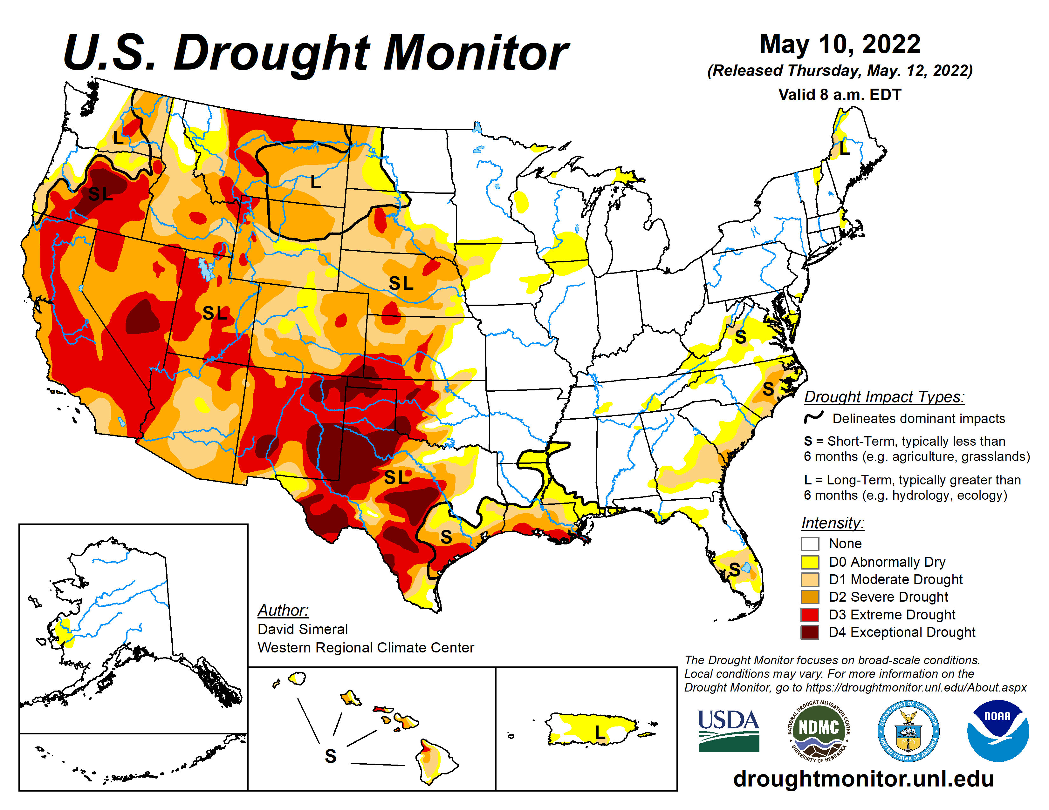
The U.S. enters the growing season with a multi-year drought over much of the western half of the country.
Spring rainfall has replenished soil moisture levels in the Western Corn Belt.
If the drought expands eastward, it will have a significant impact on some of the largest soybean/canola producing regions of the country.
Fastmarkets | Agricultural Forecasting

Slide 20
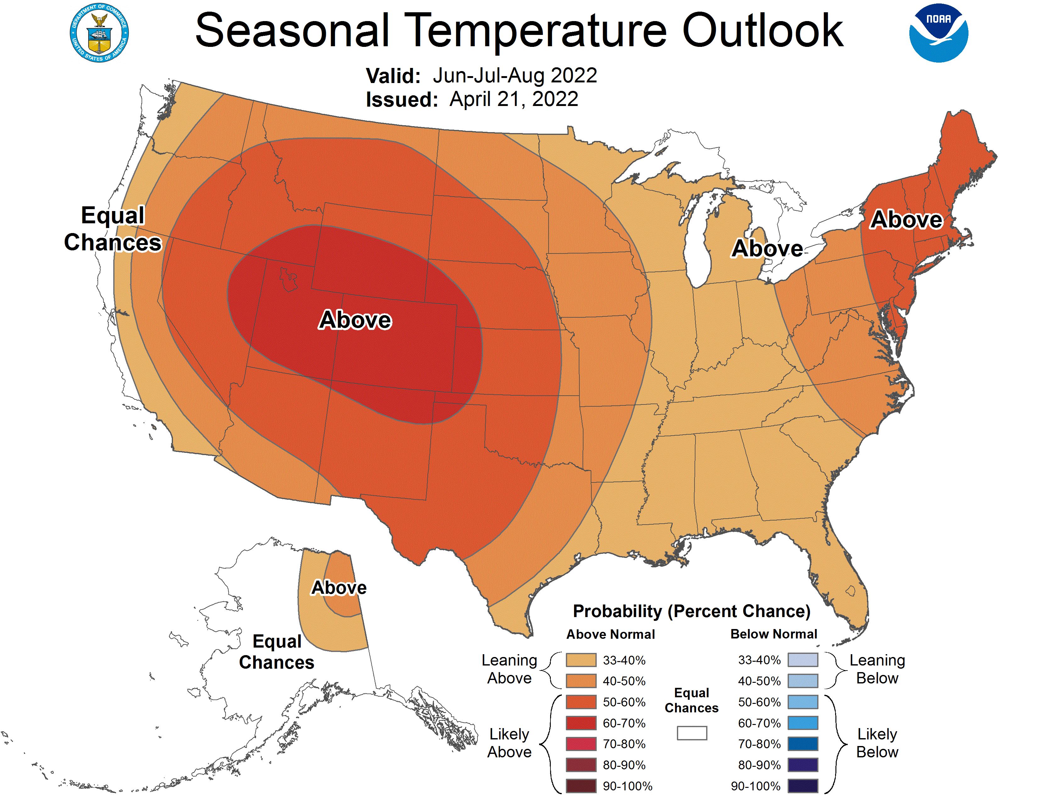
NOAA expects summer temperatures to be above normal across most of the country.
A shift in the jet stream eastward would shift the greater chances for above average temperatures into the Western Corn Belt.
Fastmarkets | Agricultural Forecasting

Slide 21
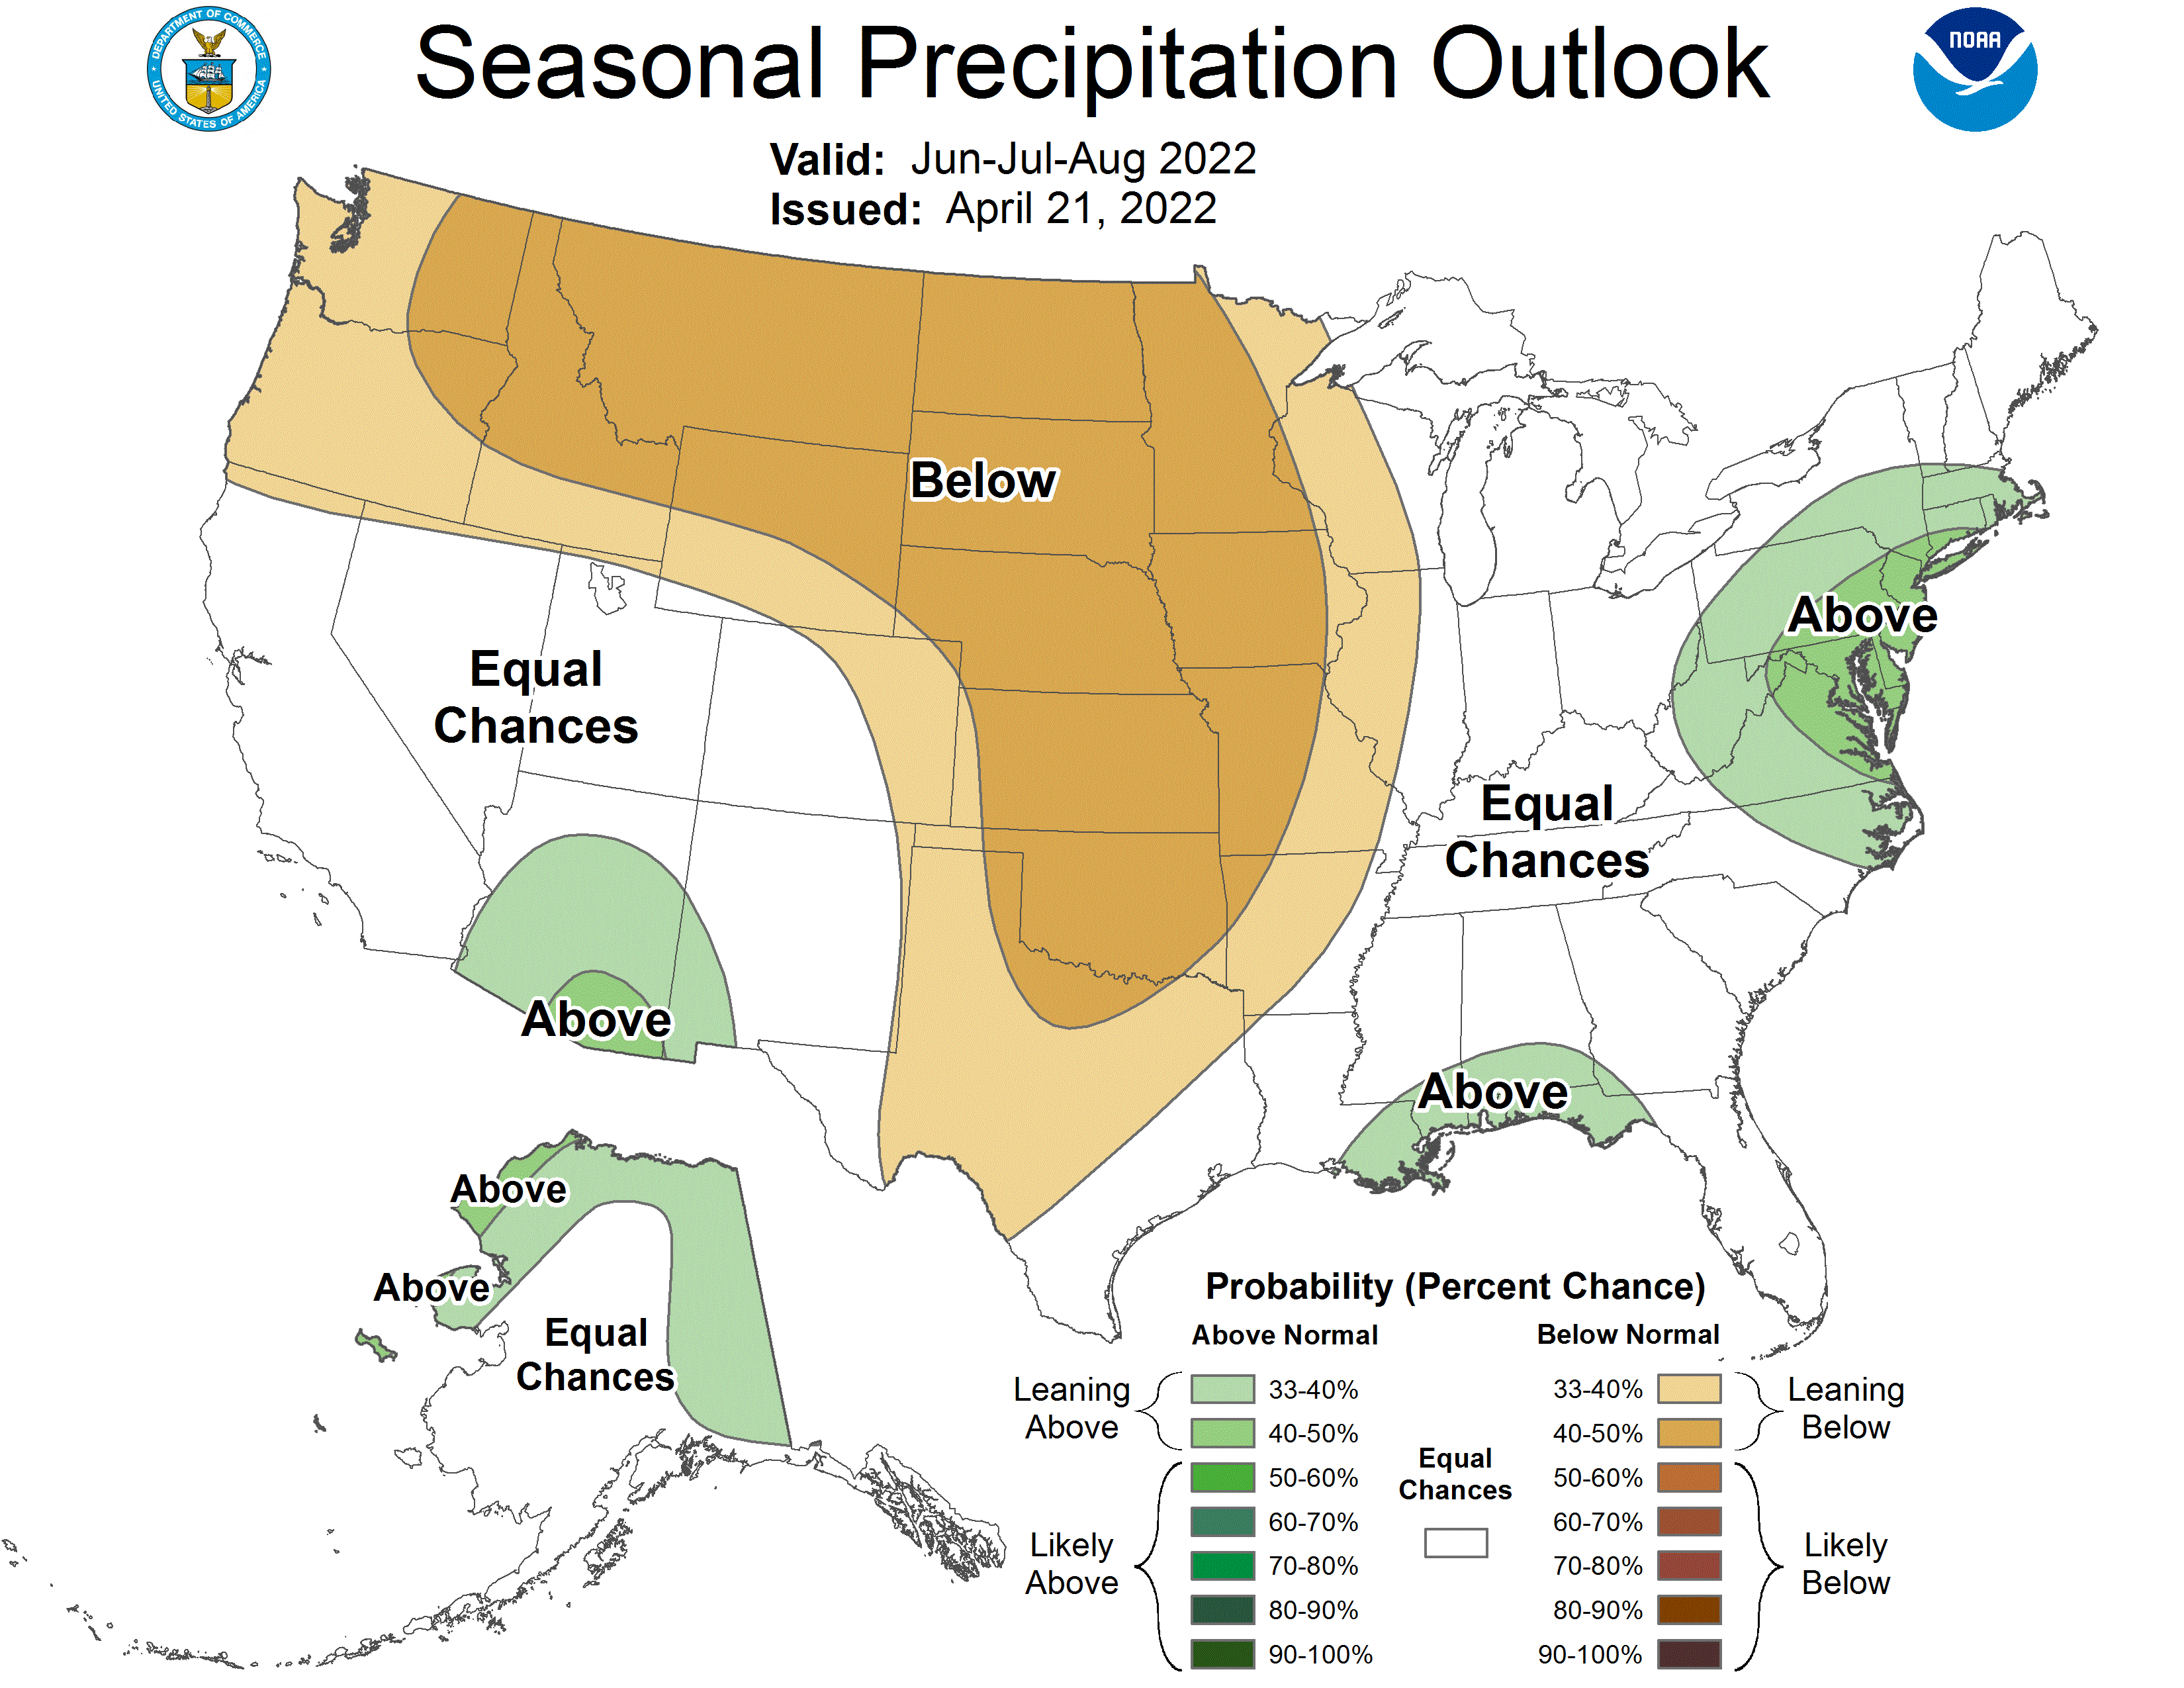
NOAA expects drought to continue in canola growing regions of the U.S. and Canada.
Below normal rainfall during August in Iowa would substantially reduce U.S. soybean yields.
NOAA’s Spring Outlook predicts drought will continue or worsen in much of the Western Corn Belt and Mississippi Delta during the spring, increasing the need for summer rainfall.
Fastmarkets | Agricultural Forecasting

Slide 22
USDA reported farmers intend to plant 91 million acres.
Based on The Jacobsen’s demand forecasts and 2021/22 ending stocks forecast, demand rationing is likely to occur if delays reduce planted area by more than one million acres.
Fastmarkets | Agricultural Forecasting

Slide 23
Tight stocks, robust export and crush demand and speculative buying driven by broader strength in commodities pushes The Jacobsen’s expectation for soybean prices to the upper end of the historical range.
Prices typically peak in June or early July, following the end of planting.
Fastmarkets | Agricultural Forecasting

Slide 24
This year, The Jacobsen expects soybean prices to remain well supported through the U.S. harvest.
The first significant opportunity for a price break is the beginning of the South American growing season.
Fastmarkets | Agricultural Forecasting

Slide 25
The price of soybeans accounts for about 85 percent of the price of soybean oil.
While the $16 projection for November soybeans implies a soybean oil price above 60 cents, the upside risk is much greater than in an average year.
Over the last year, the price relationship has skewed above the trendline, suggesting greater upside risk.
Fastmarkets | Agricultural Forecasting

Slide 26
The low elasticity of demand among domestic end users will limit demand destruction in soybean oil. However, The Jacobsen believes that unless there is another problem with weather in a major growing area the highs for soybean oil have likely been set for the year.
It will be nearly impossible for the US to import four billion pounds of soybean oil. However, it is hard to make the balance sheet work without the imports.
Fastmarkets | Agricultural Forecasting

Slide 27
The Jacobsen predicts monthly vegetable oil use in biofuel production will grow to nearly two billion pounds by the end of 2023/24.
A sharp reduction in soybean oil use in biodiesel production should offset a portion of the growth in demand. However, the growth will require substitution in the feed manufacturing and food industries.
Fastmarkets | Agricultural Forecasting

Slide 28
Non-biofuel demand grows slowly, but the low elasticity of demand for many end users sets a floor on usage.
As demand for biofuel feedstocks grow, the U.S. will import more palm oil and canola oil for use in the feed and food manufacturing industries.
Fastmarkets | Agricultural Forecasting

Slide 29
Profitability of biodiesel production from soybean oil has remained well below the long-term average for much of the past year.
As a result, The Jacobsen estimates that soybean oil’s percent of the biodiesel feedstock mix has declined from an average of more than 60 percent in 2020, to less than 50 percent in recent months.
Fastmarkets | Agricultural Forecasting

Slide 30
While the profitability of renewable diesel production using soybean oil is generally above biodiesel, it has fallen well below its longer-term average over the last year.
Despite the relative profitability, soybean oil will remain a critical feedstock for both renewable diesel and biodiesel until advanced feedstocks are widely available.
Fastmarkets | Agricultural Forecasting

Slide 31
Refining margins have exploded due to capacity constrains. However, domestic basis also needs to discourage exports.
As new refining capacity comes online margins will come under pressure. However, the reduction in the availability of crude due to the growth of pretreatment capacity at renewable diesel producers may limit the downside risk for refined basis.
Fastmarkets | Agricultural Forecasting

Slide 32
The major crushers continue to announce new crushing facilities or expansions in response to the anticipated growth in vegetable oil demand.
The increase in U.S. crushing capacity will likely pressure Argentine crush margins as rising U.S. soybean meal exports weigh on world prices.
Fastmarkets | Agricultural Forecasting

Slide 33
The Jacobsen expects prices and volatility to remain well supported through the summer.
Prices could come under pressure following Brazilian planting.
The Jacobsen believes that prices could fall to its estimate of the long-term equilibrium of 65 cents by next summer, if there are no further disruptions to supply.
Fastmarkets | Agricultural Forecasting

Slide 34
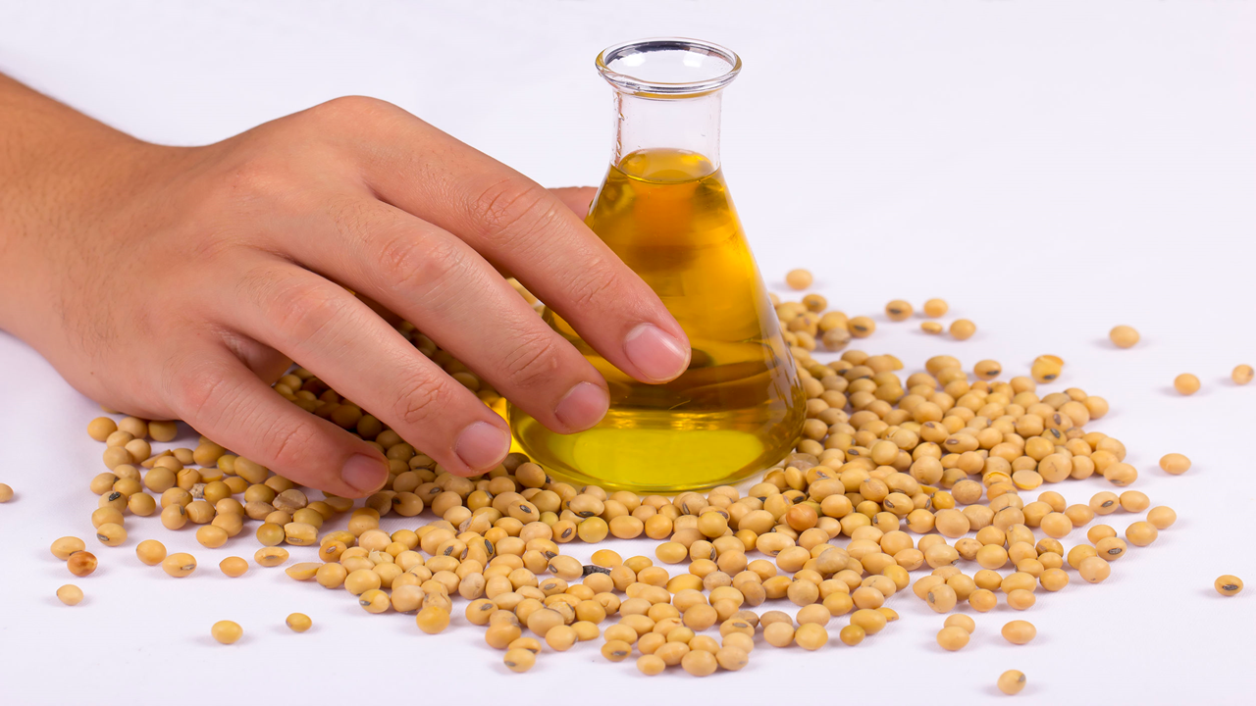

Questions?
Fastmarkets | Agricultural Forecasting

